Slide 1
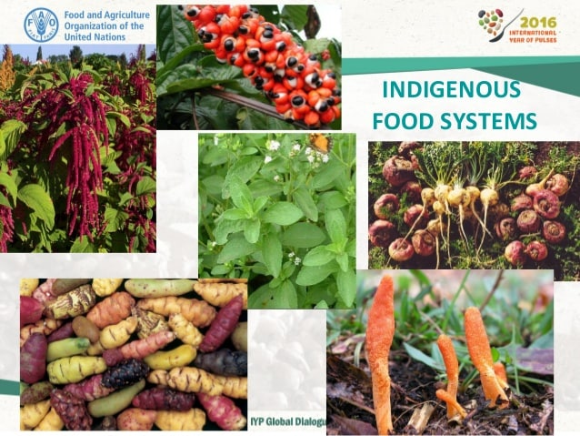
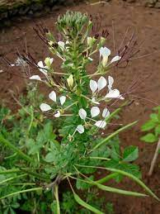
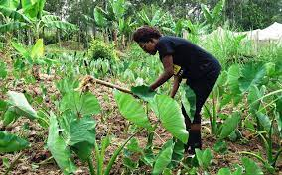
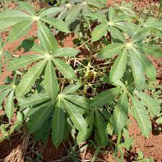
GARDENING PRACTICES.
3
Indigenous food crops
Identifying types of indigenous crops.
Cassava
The spider weed
Roots are cooked to provide food.
The leaves are used as human food
Arrow roots.
Its roots are used as food for Kenyans

Slide 2
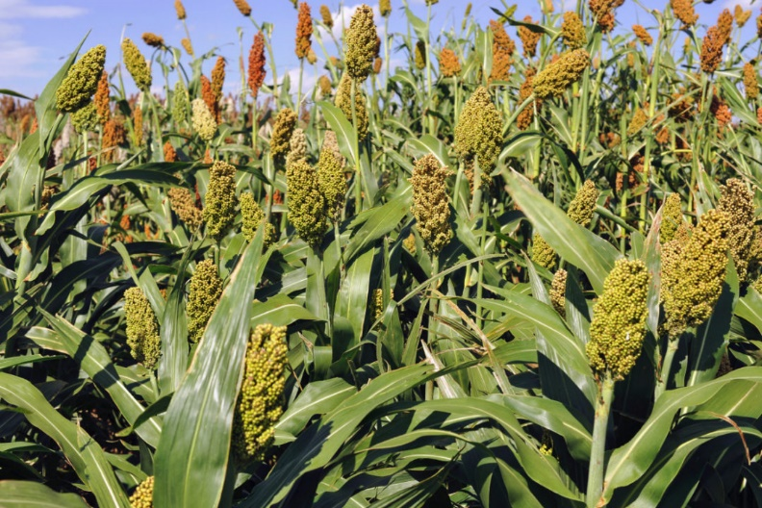
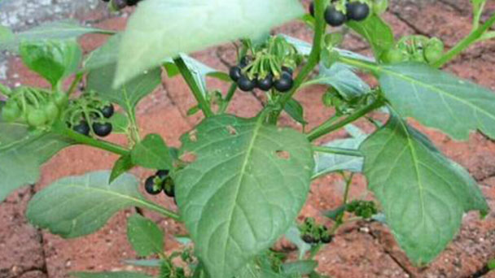
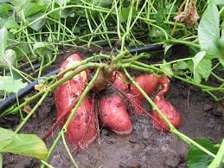
GARDENING PRACTICES.
3
Indigenous food crops
Sweet potatoes
Root tubers are cooked to give food for humans.
Sorghum
Black nightshade
Sorghum grains are used as food
Its leaves are used as indigenous vegetable.

Slide 3
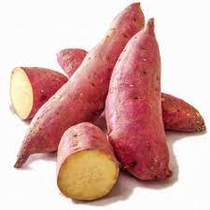
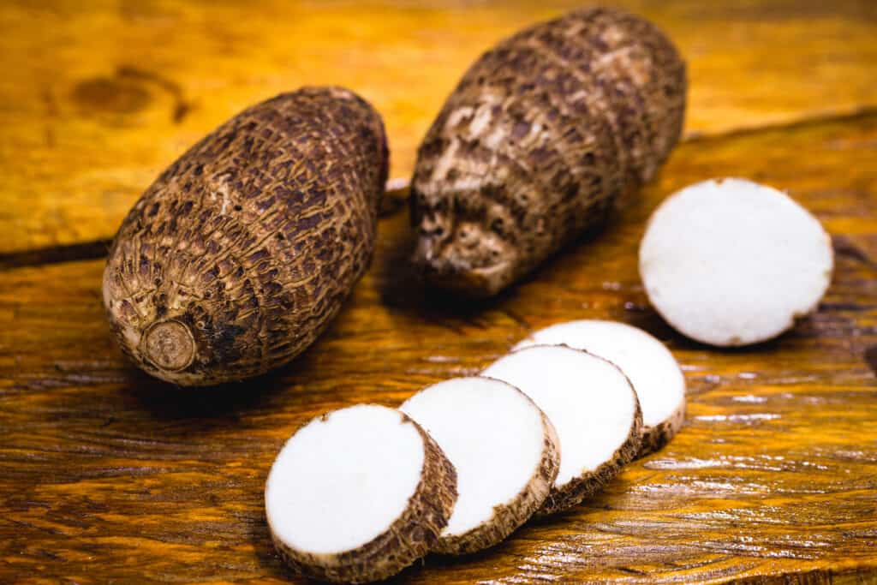
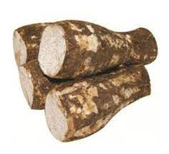
GARDENING PRACTICES.
3
Indigenous food crops
Yams
Sweet potatoes
Arrow roots

Slide 4
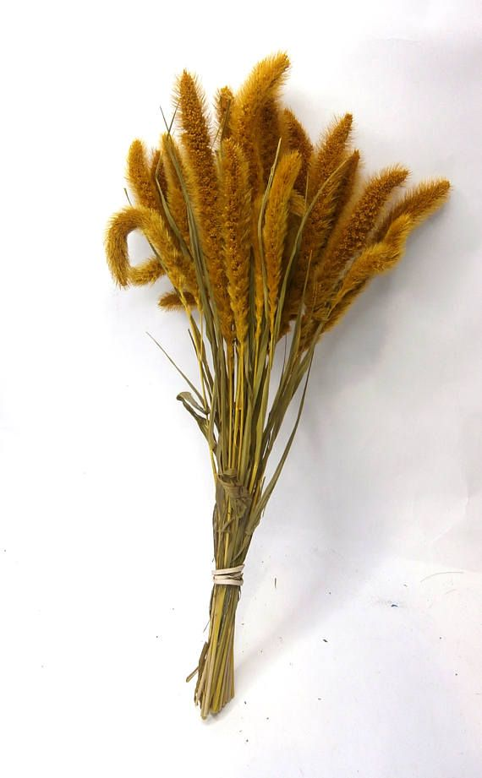
GARDENING PRACTICES.
3
Indigenous food crops
Preserving plants for exhibit.
To preserve plant leaves;
Remove moisture by drying it on the sun for a short time.
Place the leaves between two pieces of paper.
Place a heavy object on top of the papers.
Leave the setup for about a week then check if it has been preserved properly.

Slide 5
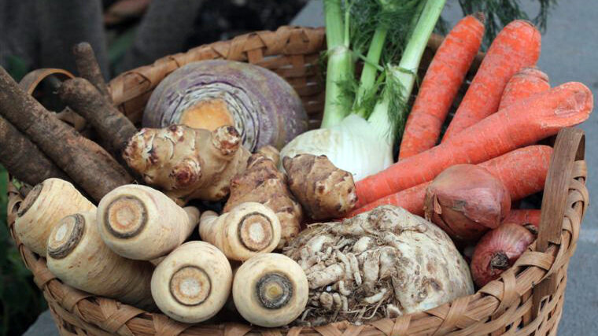
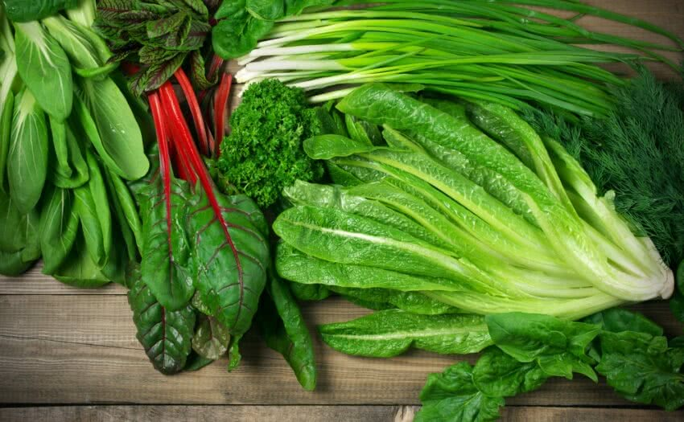
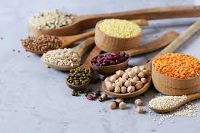
GARDENING PRACTICES.
3
Indigenous food crops
Types of food crops.
Cereals
Are crops whose grains are used for food.
Root / tuber crops
Swollen roots are harvested and prepared for food.
Green vegetable
Vegetable leaves are boiled or fried to be used as food.

