Slide 1
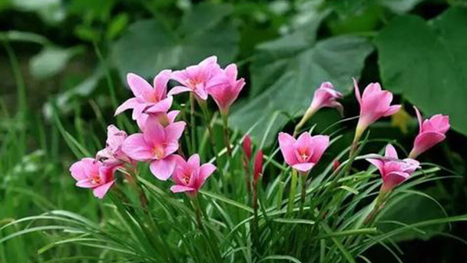
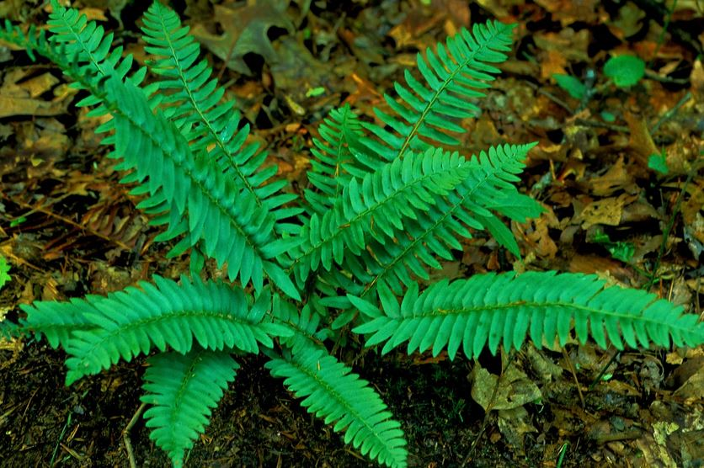
UNIT
Living Things
1
1.1 Plants
Classification of plants.
Classification of plants is the act of dividing plants into groups according to their similar features.
There are two groups of plants; Flowering and non-flowering plants.
1
2
Flowering plants.
They are plants that produce flowers.
Examples; maize plant, pawpaw and beans.
Non-flowering plants.
They are plants that don’t produce flowers.
Examples; mosses, ferns and algae.

Slide 2

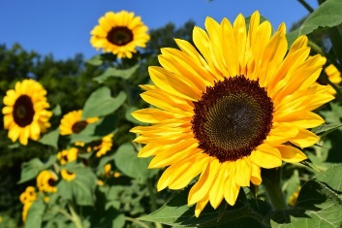
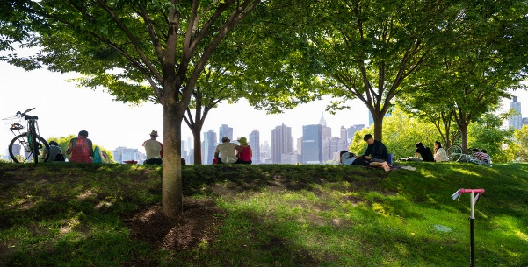
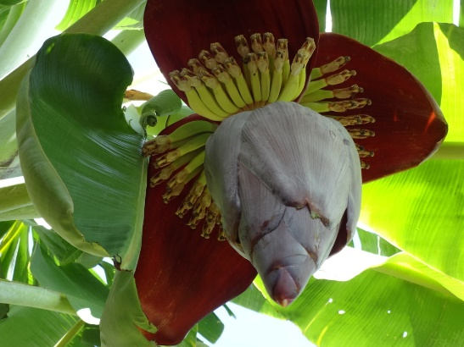
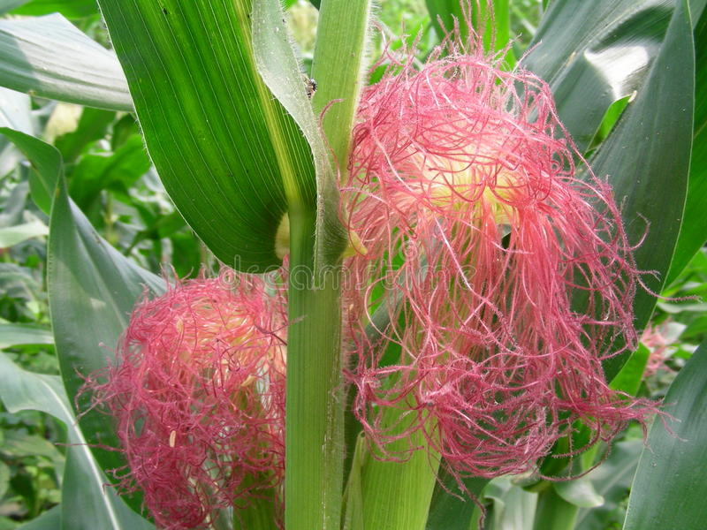
UNIT
Living Things
1
1.1 Plants
Flowering plants
Importance of flowering plants.
1. Flowering plants give us food, medicine, shade, timber and make the environment beautiful.
2. They provide animals with food
3. Some flowering plants are home for some animals.

Slide 3
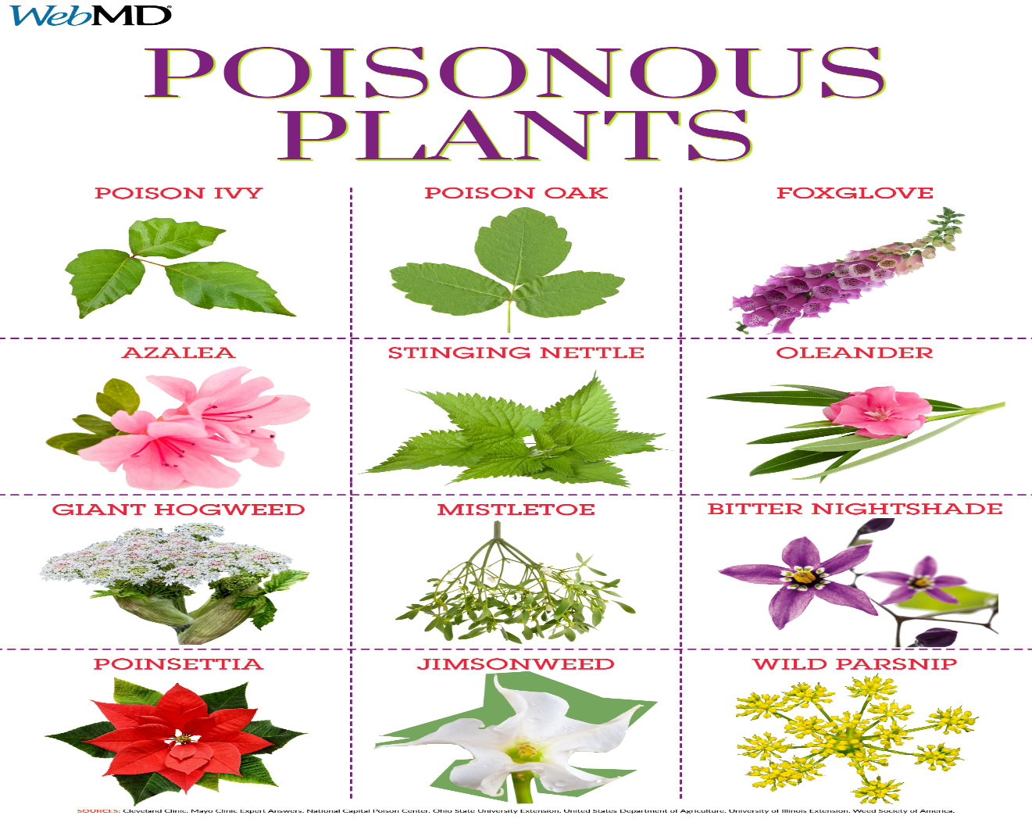
UNIT
Living Things
1
1.1 Plants
Safety precautions when handling harmful plants
Harmful plants.
Safety precautions
1. Some plants are harmful. We should take precautions when handling them.
2. We should put on protective cloths when handling harmful plants.
3. We should use a pair of forceps when handling harmful plants. Some are poisonous.
3. We should wash our hands with soap and clean water after handling harmful plants.

Slide 4
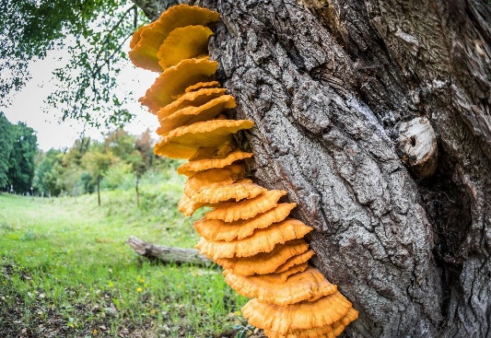
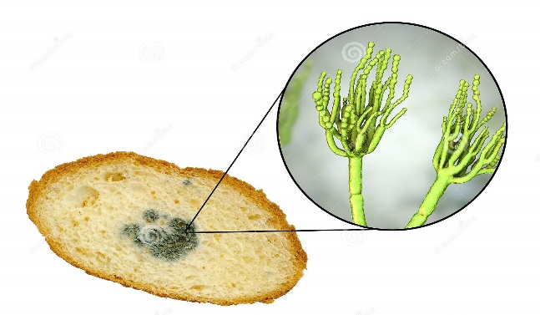
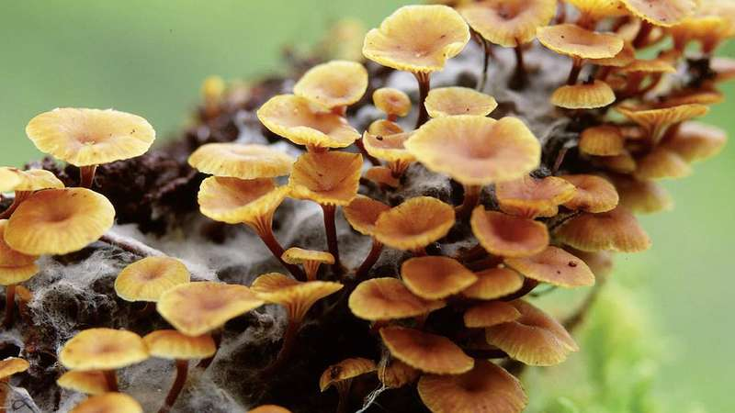
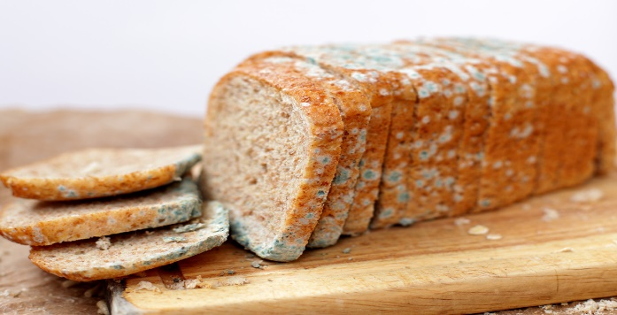
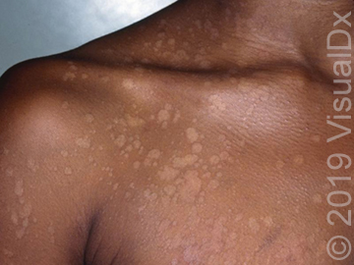
UNIT
Living Things
1
1.1 Plants
Fungi
Identifying fungi.
Fungi are living things. They are neither plants nor animals. They grow on plants or rotting things.
1
2
3
Examples of fungi.
Mushroom
Yeast
Bread moulds
puffballs
moulds
4
5
Bread moulds
Fungi skin infection

Slide 5
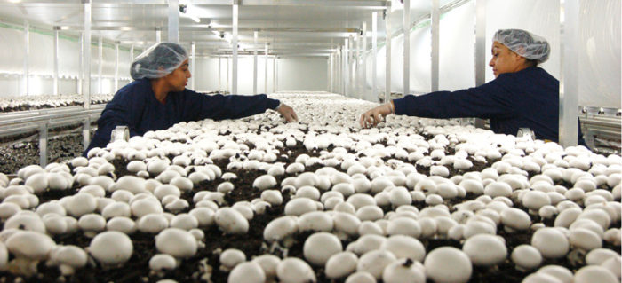
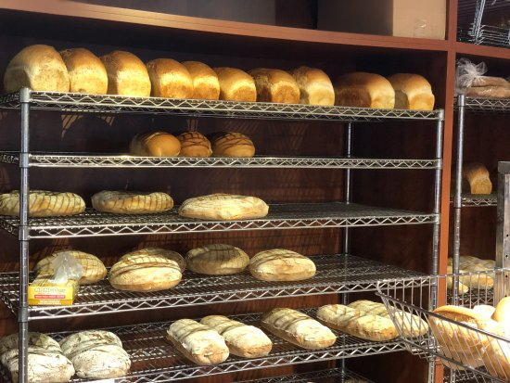
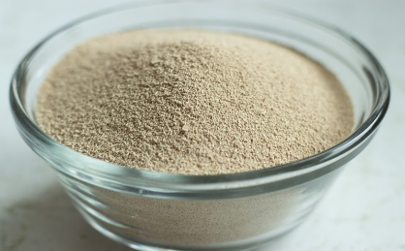
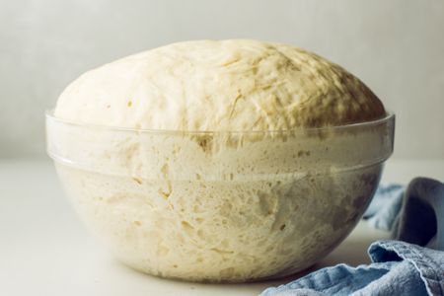
UNIT
Living Things
1
1.1 Plants
Importance of fungi.
Importance to humans.
Economic importance
1. Some fungi are used as food. Example, mushroom
1. Mushroom farming is curried out for food. They are sold on local markets and in other countries.
2. Some are used in cooking process. Yeast is used in baking ta make dough.
2. Yeast is used for making bread and cakes that are sold in shops.
3. Some fungi are used to make medicine.
4. Some are used to in making beverages.
Mushroom farming in Kenya.
Bread and cakes sold in shops.
Baking flour + yeast
Baking dough

Slide 6
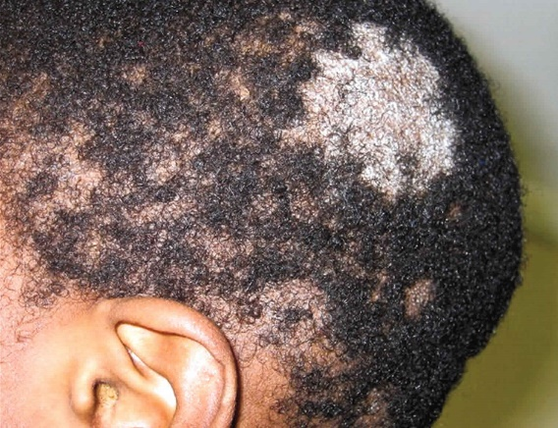
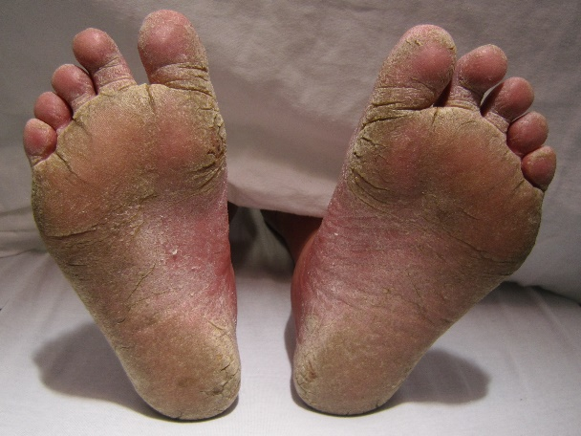
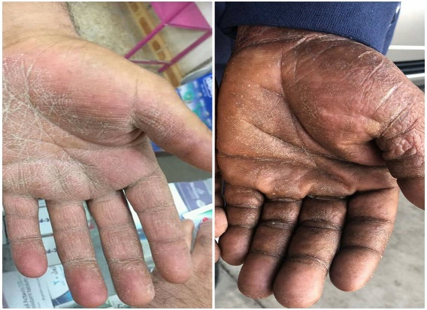
UNIT
Living Things
1
1.1 Plants
Safety precautions when handling fungi
Effects of harmful fungi.
Safety precautions
1
2
1. There are poisonous fungi. We should only collect mushrooms with the guidance of adults.
2. Always wear protective cloths such as gloves, safety boots, safety goggles and dust masks.
3
3. Always wash your hands with soap and clean water after handling fungi.

Slide 7
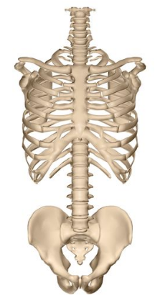
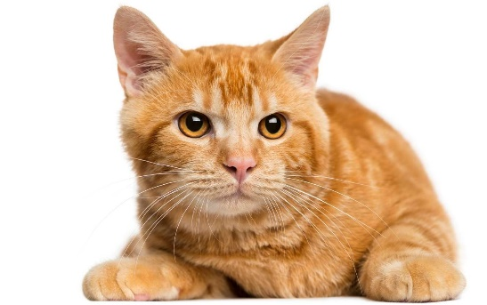
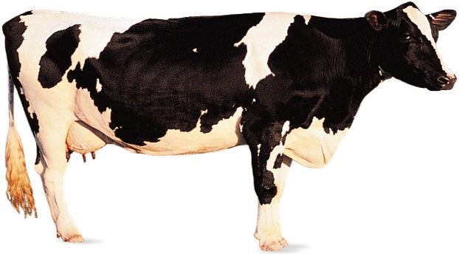
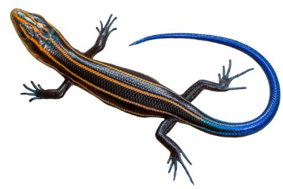
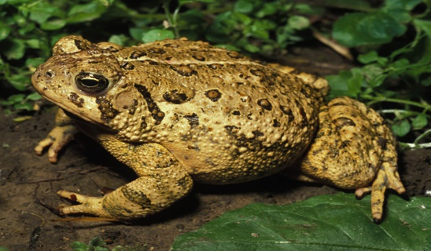
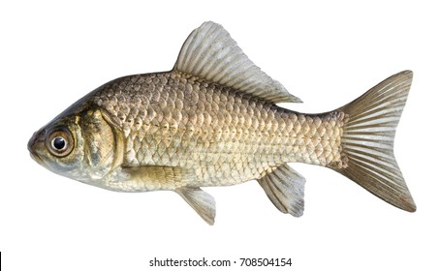
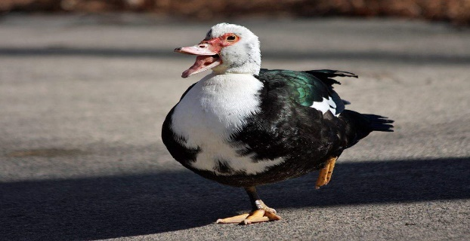
UNIT
Living Things
1
1.2 Animals
vertebrates
Vertebrates are animals that have a backbone.
They include cat, cow, lizard duck fish and frog.
Cat
Cow
Lizard
The backbone.
Frog
Duck
Fish

Slide 8
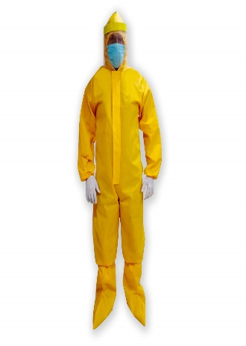
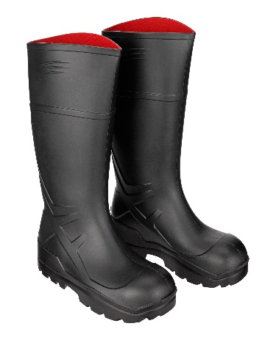
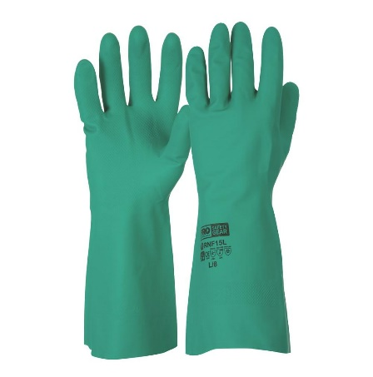
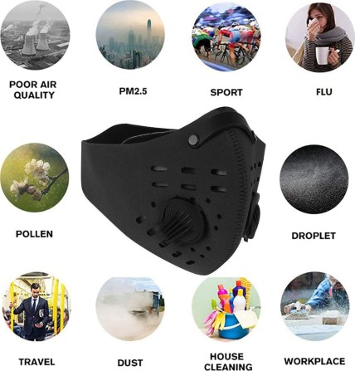
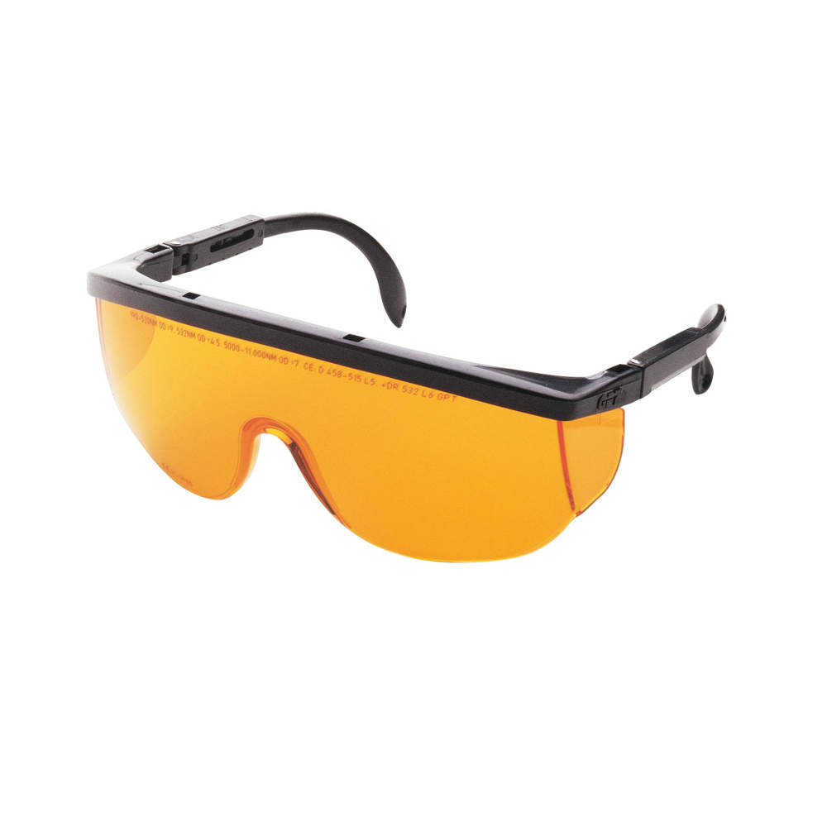
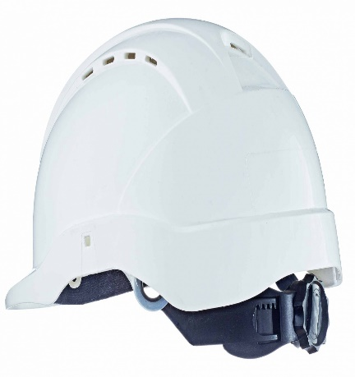
UNIT
Living Things
1
1.2 Animals
Safety precautions
Safety precautions when handling animals.
Safety apron
Safety boots
Safety gloves
Safety mask
Safety goggles
Safety helmet
Safety precautions.
1. Avoid dangerous animals.
3. Approach animals with caution.
5. Do not run when around animals.
2. Handle animals using safety gears above.
4. Be alert when around animals.
6. Avoid animals that have young ones.

Slide 9
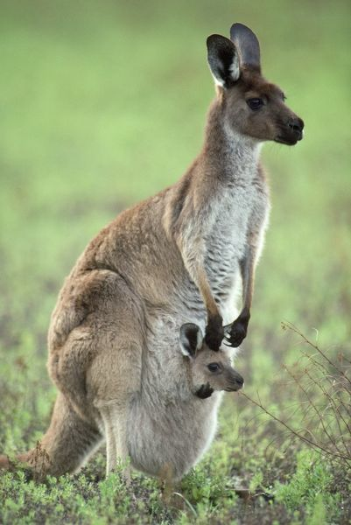
UNIT
Living Things
1
1.2 Animals
Characteristics of mammals
Vertebrates are divided into; mammals, birds, fish, reptiles and amphibians.
Mammals have a backbone,
They give birth to young ones. Some lay eggs, e.g., Duck-billed platypus.
They have mammary glands to breast feed their young ones.
Mammals live on land, some underground and others in water.
Their body is covered with fur or hair.
Mammals are warm blooded. Their body produces heat.
Example of a mammal
KANGAROO

Slide 10
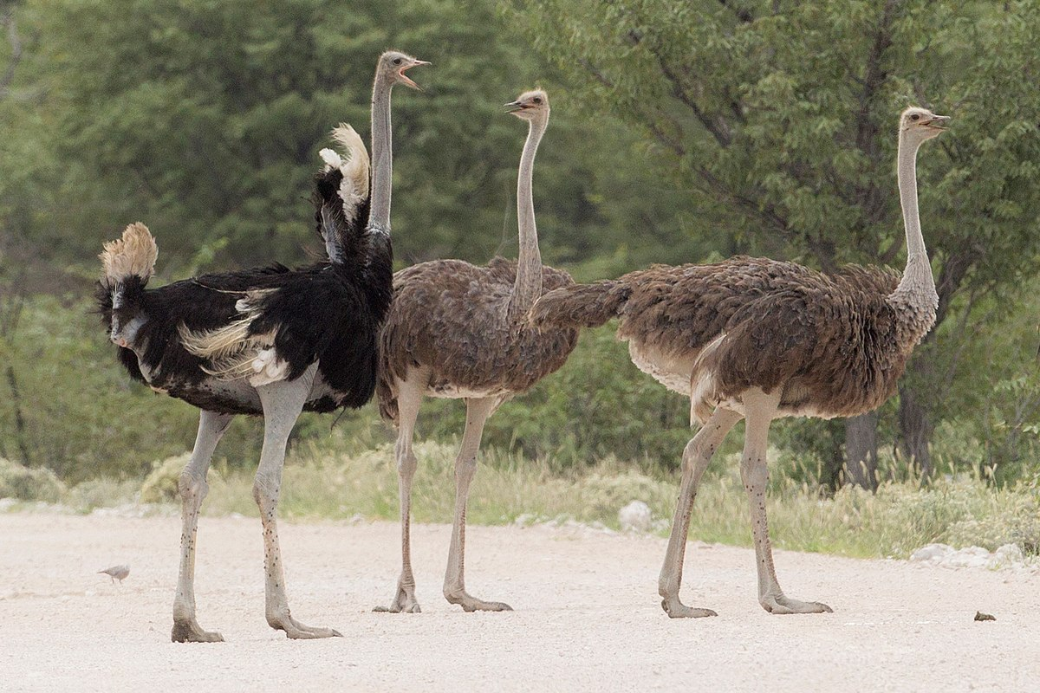
UNIT
Living Things
1
1.2 Animals
Characteristics of birds
BIRDS
Example of a bird
Birds are warm blooded.
They have a backbone.
Their body is covered with feathers.
They lay eggs that hatch into young one.
Birds have beaks.
Birds have wings.
OSTRICH

Slide 11
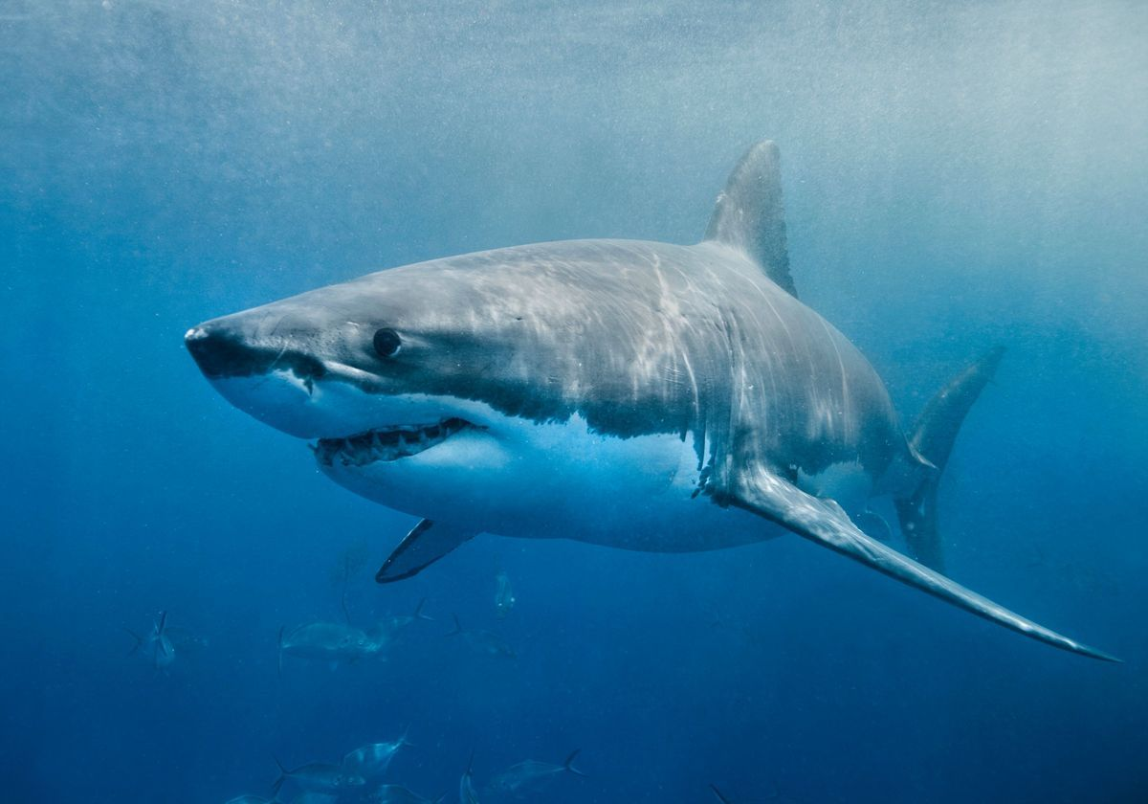
UNIT
Living Things
1
1.2 Animals
Characteristics of fish
FISH
Example of a fish.
Fish have a backbone.
They live in water.
They have fins.
Lay eggs that hatch into young ones.
Their body is covered with scales.
They are cold blooded.
They breath through gills
Fish move by swimming.
SHARK

Slide 12
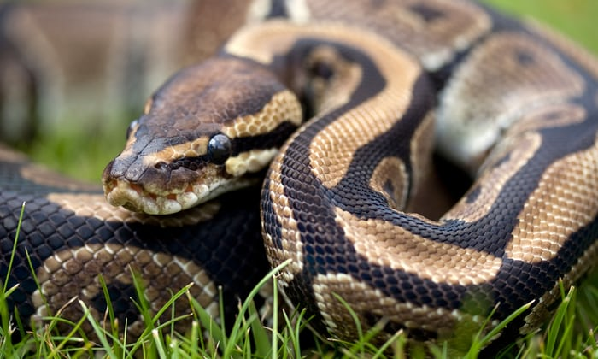
UNIT
Living Things
1
1.2 Animals
Characteristics of reptiles
Example of a reptile.
REPTILES
Reptiles have a backbone.
They are cold blooded. Their body temperature changes with the environment, cold at night and warm during the day.
Their body is covered with scales.
Reptiles live on land and in water.
They breath through the lungs.
Most of them lay eggs and hatch into young ones.
PYTHON

Slide 13
UNIT
Living Things
1
1.2 Animals
Characteristics of reptiles
Example of a reptile.
REPTILES
Reptiles have a backbone.
They are cold blooded. Their body temperature changes with the environment, cold at night and warm during the day.
Their body is covered with scales.
Reptiles live on land and in water.
They breath through the lungs.
Most of them lay eggs and hatch into young ones.
PYTHON

Slide 14
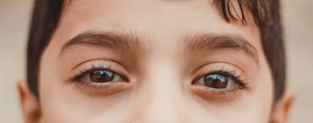
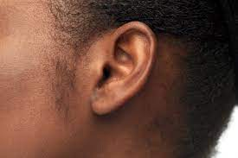
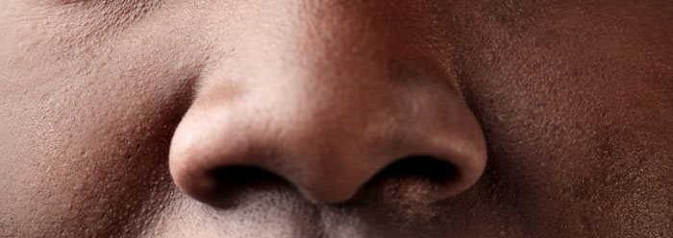
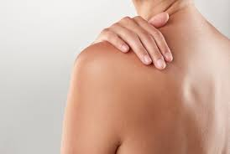
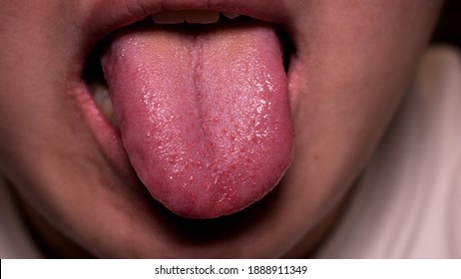
UNIT
Living Things
1
1.3 Human body
Sense organs
Human being have 5 main sense organs.
They include;
A
B
C
The eyes
The ear
The nose
D
E
The skin
The tongue

Slide 15
UNIT
Living Things
1
1.3 Human body
Functions of the sense organs
A
We use our eyes to see. We see objects and the environment using our eyes.
B
C
Ears are used to hear. We listen and sense sound using our ears.
The tongue
The eyes
The ear
The tongue is use to taste. With the tongue, we can sense sugary or salty food using the tongue.
The skin tells us if it is hot or cold, rough or smooth, or when we are hurt and feeling pain.
D
E
We smell with our nose. The nose is used to sense good or bad smell
The skin
The nose

Slide 16
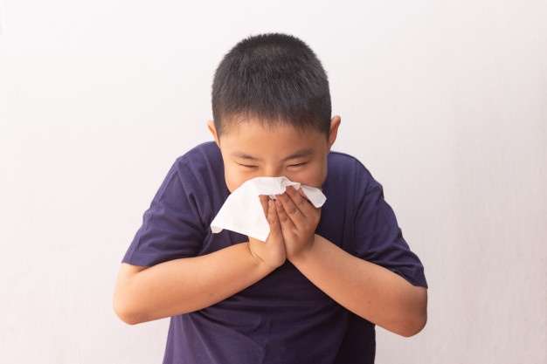
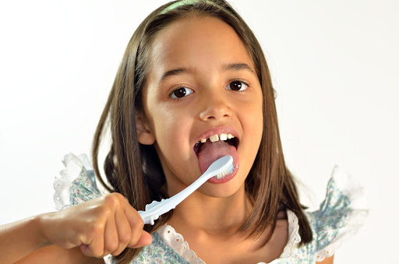
UNIT
Living Things
1
1.3 Human body
Care for sense organs
We should bath daily using soap and clean water.
We should apply oil on our skin to keep it moist.
We should always brash our tongue and teeth when cleaning our mouth.
We should keep our nose clean using a clean handkerchief.
We should clean our ears using cotton buds.
We should not put sharp objects in our nose or ears.

Slide 17
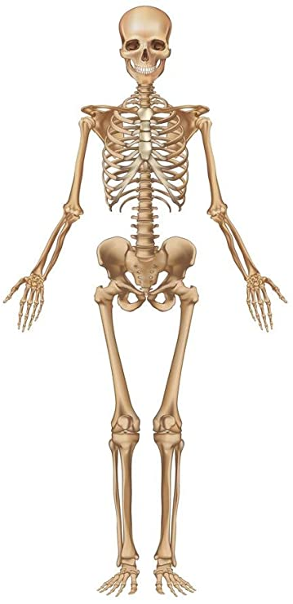
UNIT
Living Things
1
1.3 Human body
The human skeleton
Skull
Ribcage
FUNCTIONS OF THE HUMAN SKELETON.
Limb bones
The skull protects the brain from injury.
The backbone provides support to the entire body and helps the body to remain upright.
The ribcage protects the heart and lungs.
The limb bones supports the weight of the human body.
Backbone (spine)
Limb bones

Slide 18
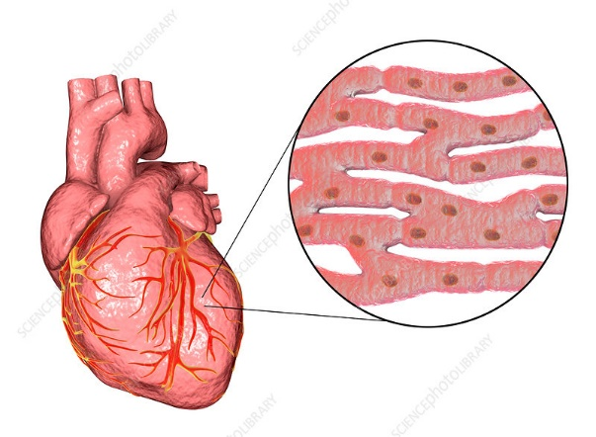
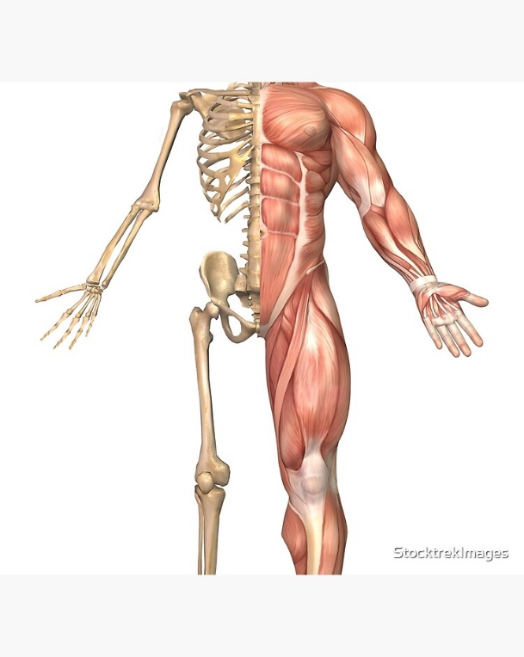
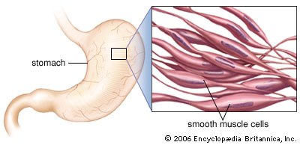
UNIT
Living Things
1
1.3 Human body
The human muscles
Three types of muscles.
Skeletal muscles and their functions
1
3
Skeletal muscles are typically attached to bones by tendons (stringy tissue) so we can use these muscles to move our bones, to move our bodies.
Cardiac muscles are found in the heart. They are the heart muscles.
Cardiac muscles
They support and help the body to move.
They control body temperature.
They keep the body upright.
They protect other organs in the body.
2
Smooth muscles are found in the stomach and the intestines. They are also called involuntary muscles.
Skeletal muscles
Also call voluntary muscles.
Smooth muscles

Slide 19
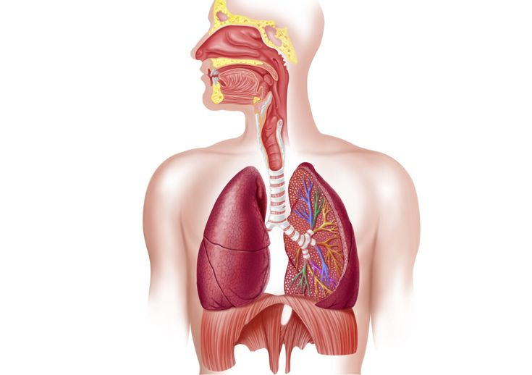
UNIT
Living Things
1
1.3 Human body
The breathing system.
Functions of the parts of the breathing system.
Air enters through the nose. The tiny hair in the nose traps dust, while mucus from mucus gland clean the air. The blood capillaries in the nose are used to warm the air.
The trachea or windpipe, receives air from the nose and passes it into the lungs.
The lungs take in oxygen gas in the air and lets out carbon dioxide that is not needed in the body.
The diaphragm helps the lungs to be filled with air by moving up and down. The diaphragm expands to let air into the lungs, and relaxes to let air out.
Nose
Trachea
Lungs
Diaphragm

Slide 20
UNIT
Living Things
1
1.3 Human body
The breathing system.
Functions of the parts of the breathing system.
Air enters through the nose. The tiny hair in the nose traps dust, while mucus from mucus gland clean the air. The blood capillaries in the nose are used to warm the air.
The trachea or windpipe, receives air from the nose and passes it into the lungs.
The lungs take in oxygen gas in the air and lets out carbon dioxide that is not needed in the body.
The diaphragm helps the lungs to be filled with air by moving up and down. The diaphragm expands to let air into the lungs, and relaxes to let air out.
Nose
Trachea
Lungs
Diaphragm

Slide 21
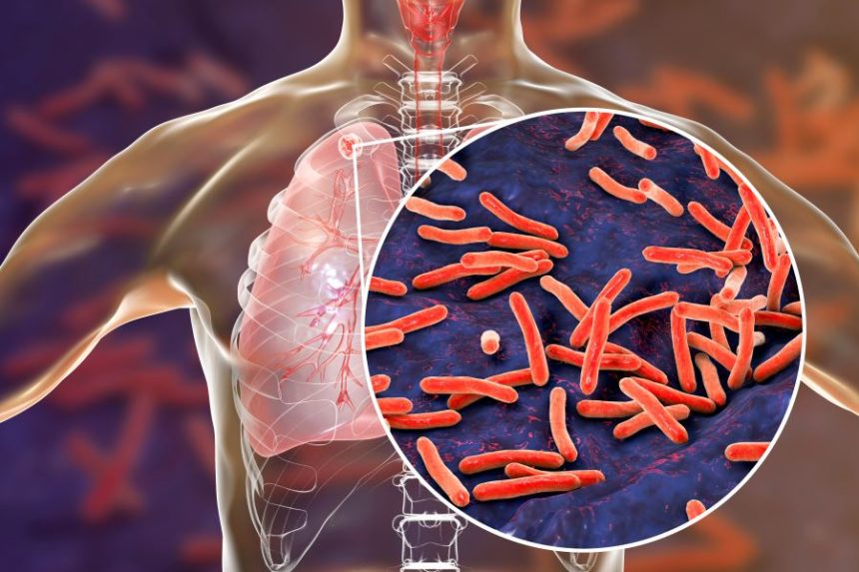
UNIT
Living Things
1
1.3 Human body
Diseases of the breathing system
Tuberculosis (TB)
Similar diseases
Pneumonia
Colds
Coughs
influenza
Signs and symptoms.
Fever
Fatigue
Night sweats
Coughing blood
Weight loss
Coughing for 3 or more weeks
Chest pain.
TB affects the lungs and is caused by a bacteria. Is spread from one person to another through sneezing, coughing or spitting.
Prevention of TB
Stay in a ventilated room
Vaccinating infants
Cover the mouth when sneezing
Finish up your dosage
Ware a mask in public places.

Slide 22
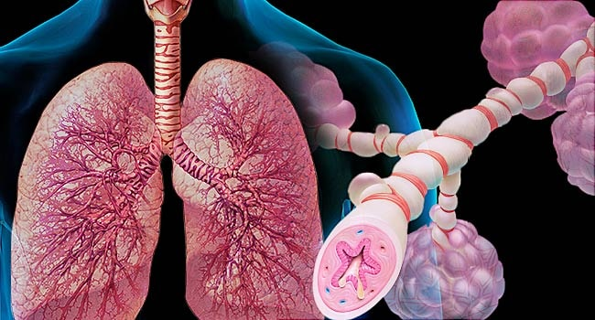

UNIT
Living Things
1
1.3 Human body
Diseases of the breathing system
Asthma
Prevention of COVID-19
Signs and symptoms
Getting vaccinated for influenza and pneumonia
Identifying and avoiding asthma triggers.
Monitoring your breath
Treating early attacks
Take medications as prescribed by a doctor
Complete your dose.
Shortness of breath
Chest pain
Whistling sound when breathing
Coughing
Asthma narrows and swells the airways in the lungs, producing extra mucus.

Slide 23

UNIT
Living Things
1
1.3 Human body
Sense organs
Coronavirus (COVID-19)
Prevention of COVID-19
Signs and symptoms
Wash your hands always for about 20 seconds
Use a handkerchief when sneezing or coughing
Avoid touching your mouth, nose or eyes.
Clean and disinfect surfaces and objects before using.
Stay at home during outbreak, keep a social distance of about 2m.
When sick, seek doctor’s attention.
Fever
Dry cough
Tiredness
Sore throat
Headache
Lose of taste or smell.
Covid-19 is caused by a virus called coronavirus. The disease affects the breathing system.

