Slide 1
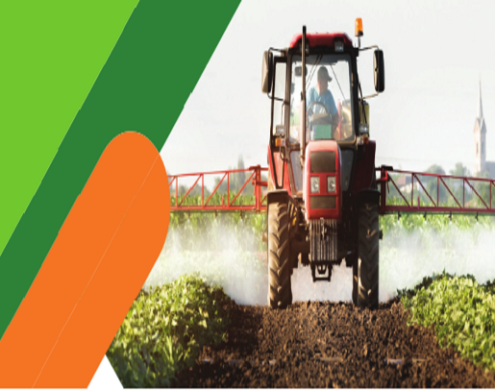
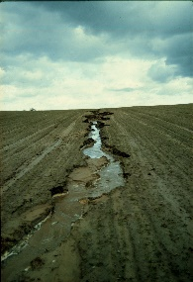
CONSERVING OUR ENVIRONMENT
1
Soil conservation
Developed by Charles Juma
Soil recovery.
Soil recovery is restoring eroded soil back to a better state.
Soil erosion refers to the wearing away of a field's topsoil by the natural physical forces of water and wind or through forces associated with farming activities such as tillage.

Slide 2
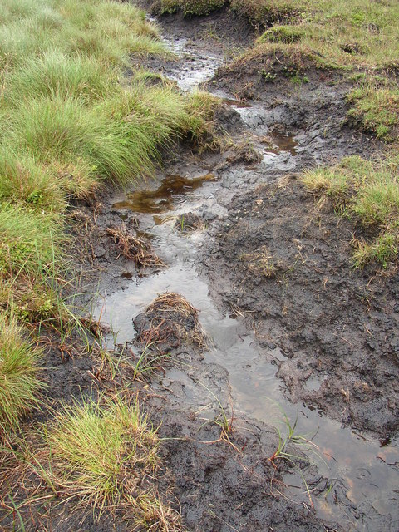
CONSERVING OUR ENVIRONMENT
1
Soil conservation
Developed by Charles Juma
Runoff
Runoff water is the excess water that flows on the ground surface.
The runoff erodes the top soil. The process by which the top soil is removed and carried away to another place is called soil erosion.
Soil erosion leads to loss of nutrients in the soil, leading to poor growth of plants.

Slide 3
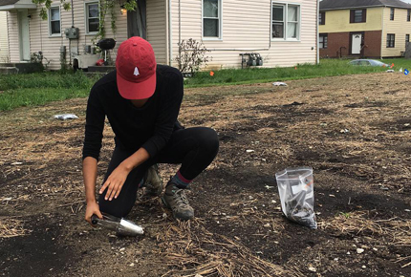
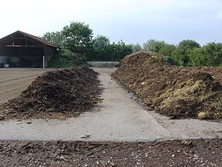
CONSERVING OUR ENVIRONMENT
1
Soil conservation
Developed by Charles Juma
Using recovered soil for farming.
Soil recovery is the process of collecting soil from deposition sites and using it to replace the lost top soil.
Recovered soil is very fertile and is useful for farming and growing plants.

Slide 4
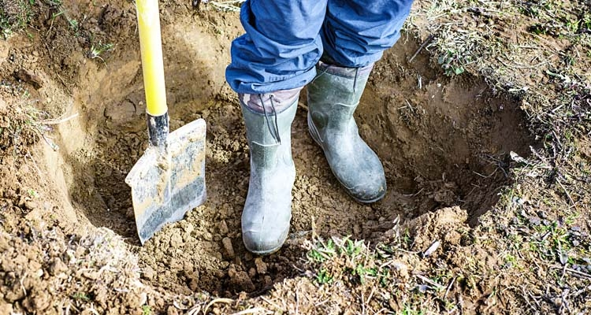
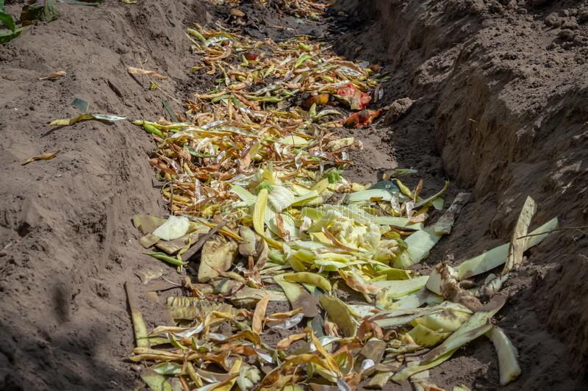
CONSERVING OUR ENVIRONMENT
1
Soil conservation
Developed by Charles Juma
Soil improvement.
This is the act of adding nutrients in the soil.
We add nutrients in the soil when we add organic manure to our soils.
Compost manure is best used in improving our soil. Two methods of preparing compost manure is by hip method or the pit method.
Soils improved by addition of organic waste manure is suitable to be used in growing crops.

Slide 5
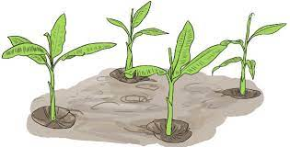
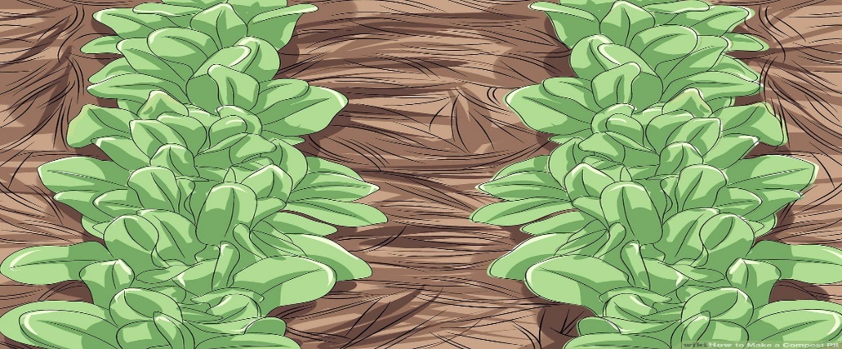
CONSERVING OUR ENVIRONMENT
1
Soil conservation
Developed by Charles Juma
Growing a crop in an organic waste pit.
Crops grow well on soils that have been improved by compost manure.
Dumping green and dry plants, food remains and kitchen wastes improves the soil.
When the dumped organic wastes decay, they release nutrients that are required to grow plants.

Slide 6
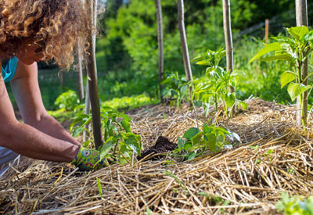
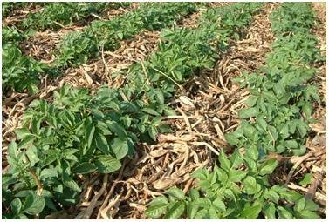
CONSERVING OUR ENVIRONMENT
1
Water conservation
Developed by Charles Juma
Mulching
A mulch is a layer of material put to the surface of the soil. Mulching help in preservation of soil dampness, improving richness and health of the soil, lowering weed growth, and improving the visual appeal of the area. A mulch is organic in nature.

Slide 7
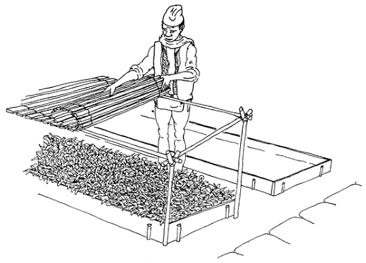
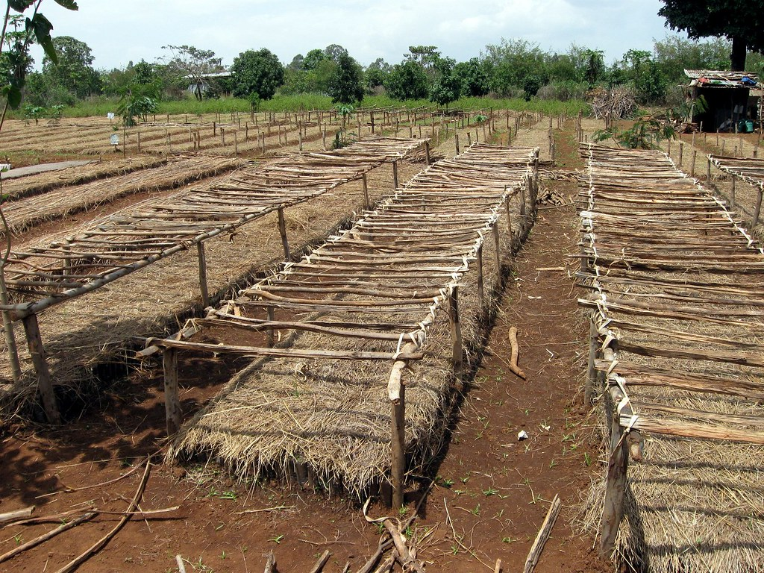
CONSERVING OUR ENVIRONMENT
1
Water conservation
Developed by Charles Juma
Shading crops
Germinating seed and recently transplanted seedlings need protection from hot sun, heavy rain and hard frost. Therefore some method of shading beds in nurseries is essential.
Shading reduces the temperature of the soil and the amount of water lost by seedlings.
However if seedlings are left under shade all the time they grow too tall, too weak and yellow

Slide 8
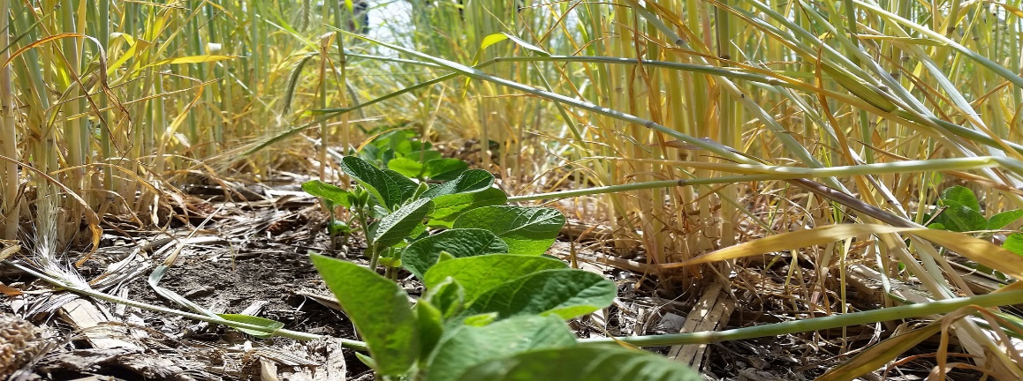
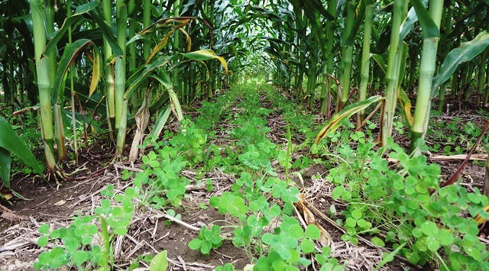
CONSERVING OUR ENVIRONMENT
1
Water conservation
Developed by Charles Juma
Cover cropping.
Cover crops are plants that are planted to cover the soil rather than for the purpose of being harvested. Cover crops manage soil erosion, soil fertility, soil quality, water, weeds, pests, diseases, biodiversity and wildlife in an agro ecosystem—an ecological system managed and shaped by humans.

Slide 9
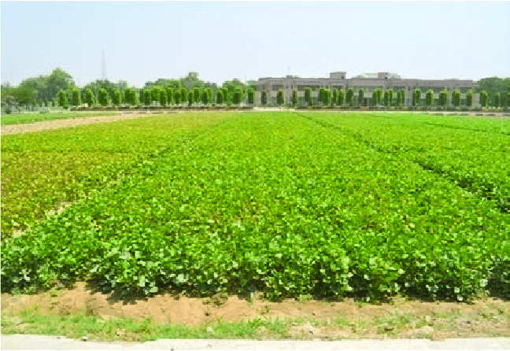
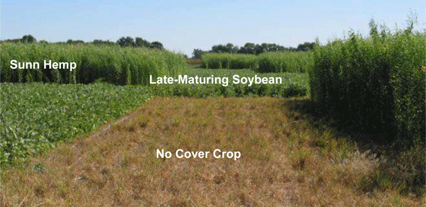
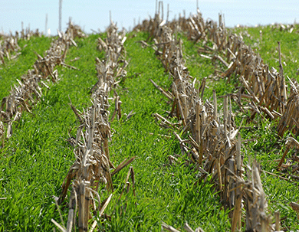
CONSERVING OUR ENVIRONMENT
1
Water conservation
Developed by Charles Juma
Pictorials
Beans act as good cover crops.

Slide 10
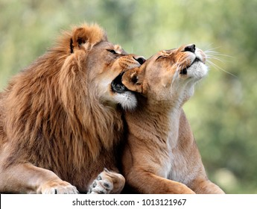
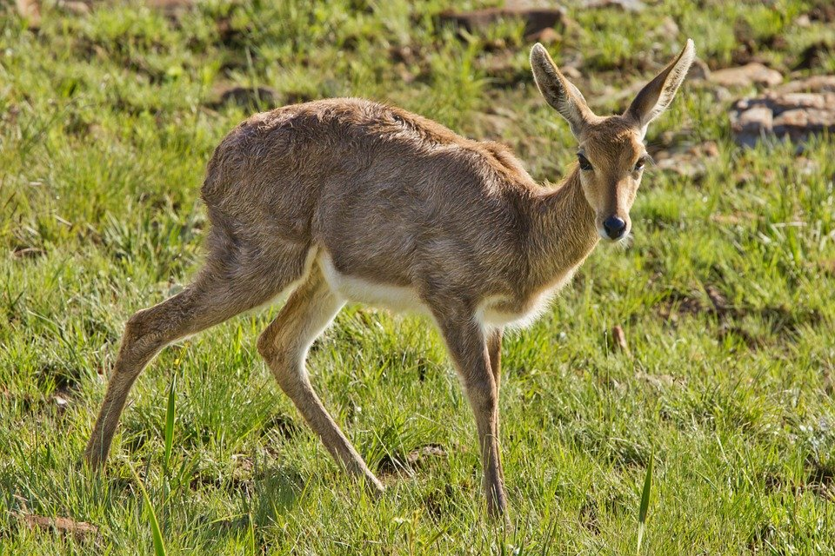
CONSERVING OUR ENVIRONMENT
1
Controlling wild animals
Developed by Charles Juma
Importance of wild animals.
Wild animals are useful to us.
They are an attraction for tourists.
They earn us money when tourists visit our country to see them.
Some wild animals are distractive. They destroy our crops and kill our domestic animals.

Slide 11
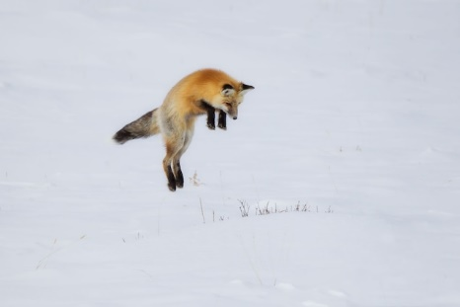

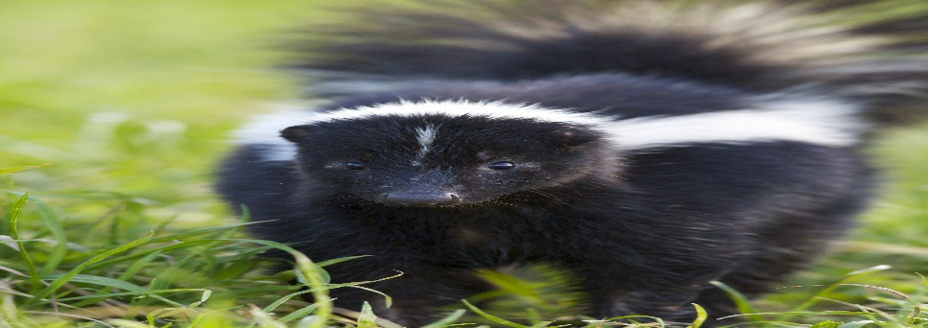
CONSERVING OUR ENVIRONMENT
1
Controlling wild animals
Developed by Charles Juma
Use of sound
Some animals are often scared by the sound of people talking or shouting. Some people use a radio to scare away wild animals.
Use of smell
Some animals are scared by the smell of certain animals.
The smell of burning rugs may be used to scare away wild animals.

Slide 12
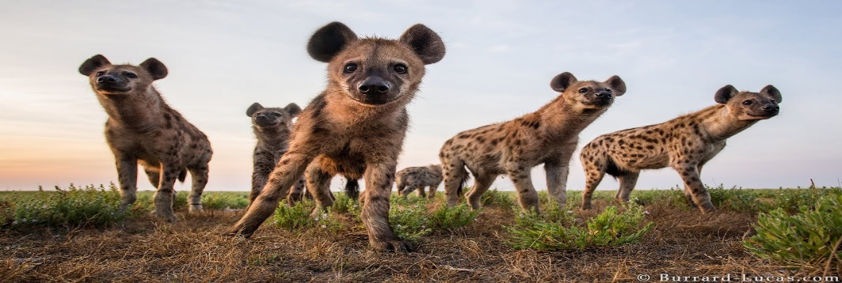
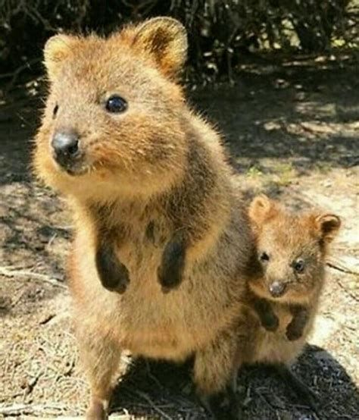
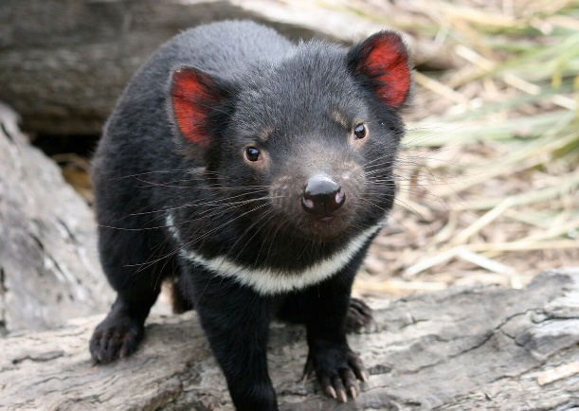
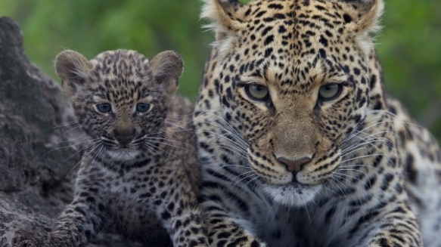
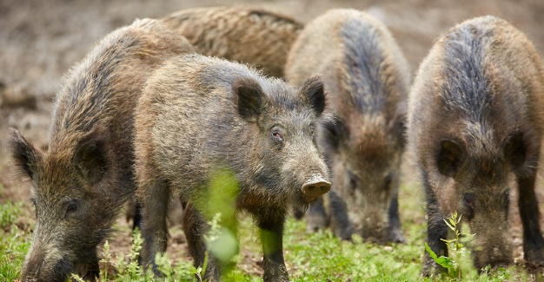
CONSERVING OUR ENVIRONMENT
1
Controlling wild animals
Developed by Charles Juma
Some wild animals are distractive.

Slide 13
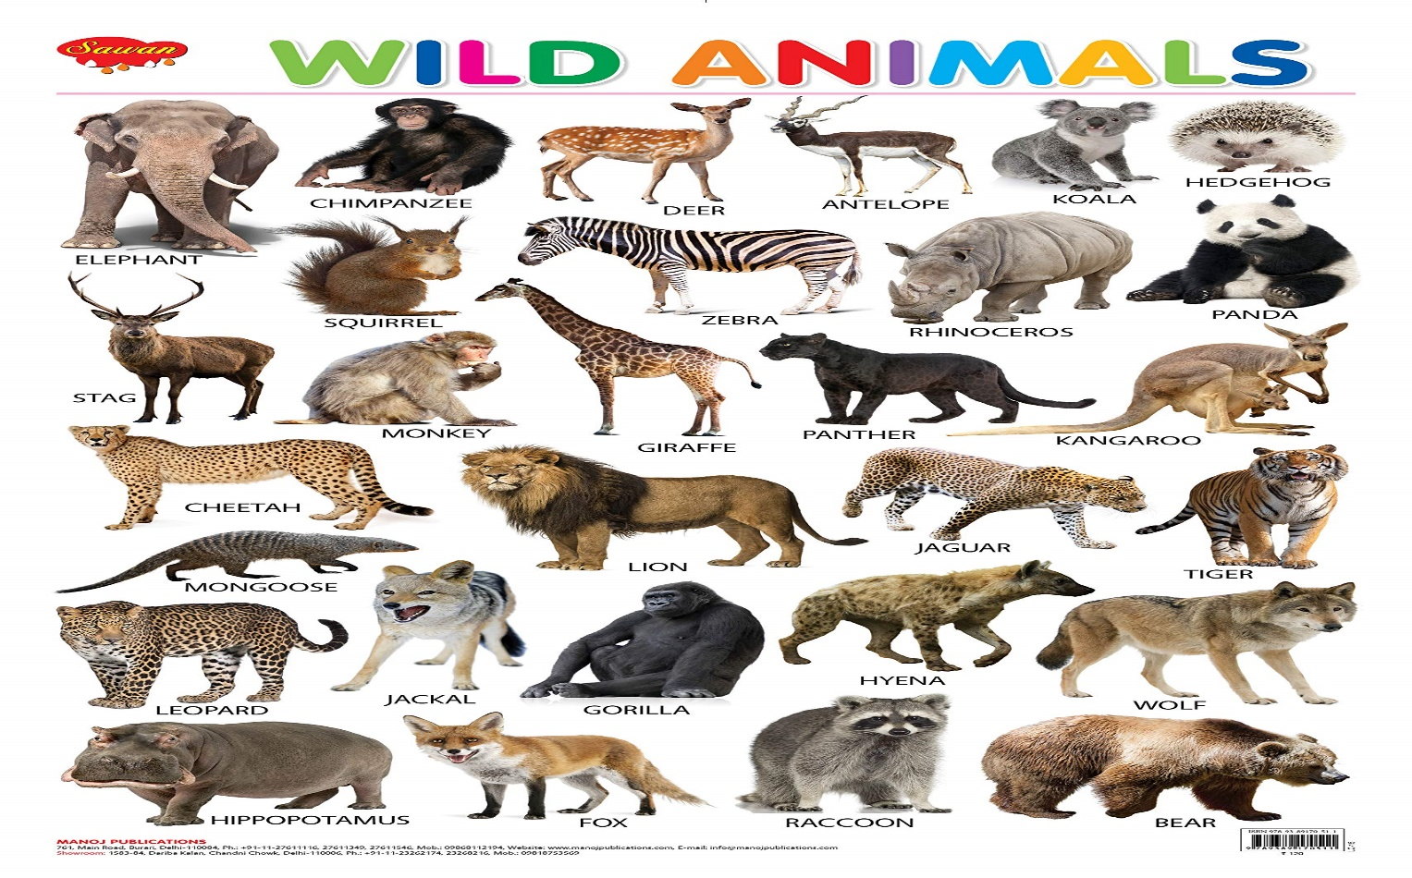
CONSERVING OUR ENVIRONMENT
1
Controlling wild animals
Developed by Charles Juma
Care and safety from wild animals
Some wild animals are dangerous and can attack or even kill us.
These animals such as monkeys, and wild dogs can transmit dangerous diseases such as rabies.

Slide 14
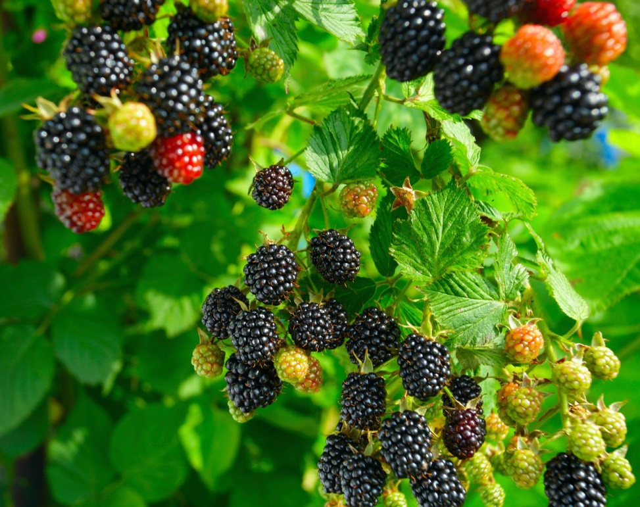
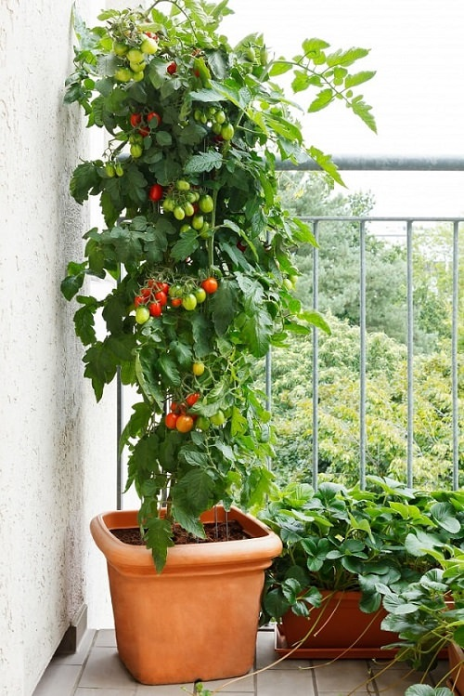
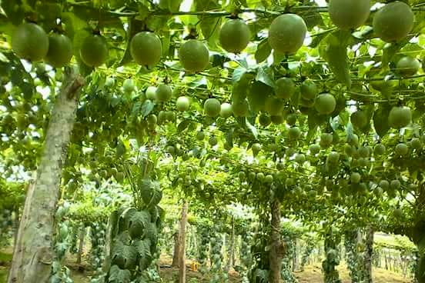
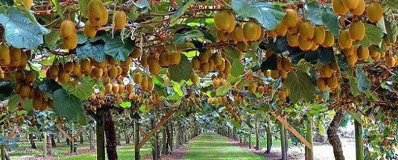
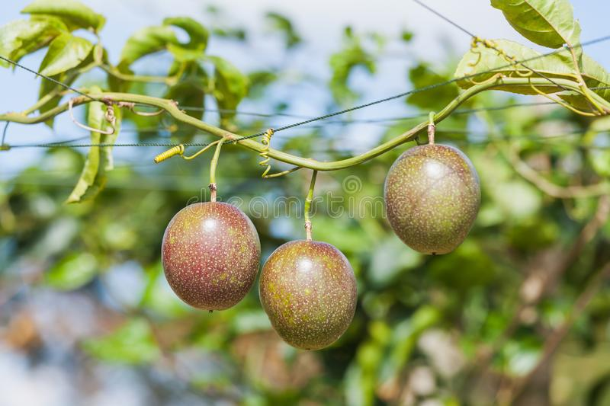
CONSERVING OUR ENVIRONMENT
1
Growing Climbing fruits
Developed by Charles Juma
Identifying climbing fruits.
Blackberries
Passion fruit
Climbing tomato
Kiwi fruits

Slide 15
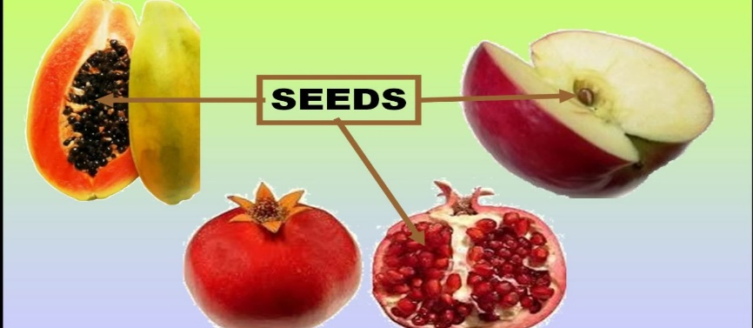
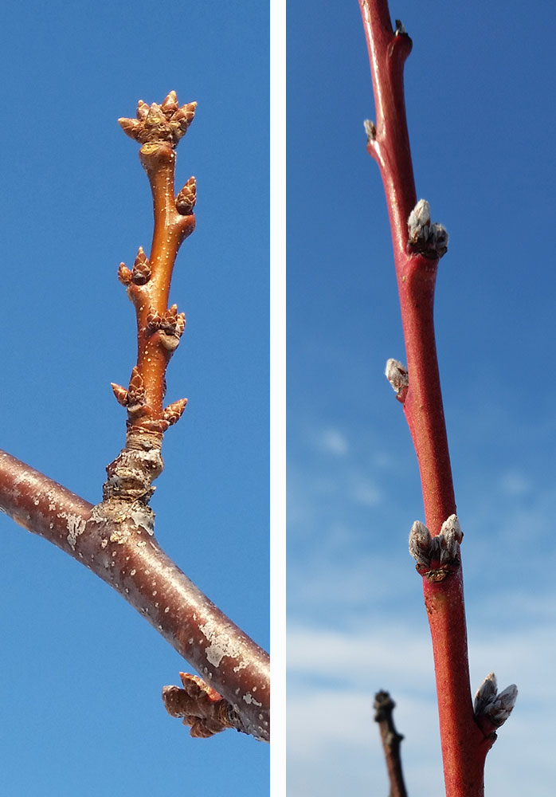
CONSERVING OUR ENVIRONMENT
1
Growing Climbing fruits
Developed by Charles Juma
Planting materials for climbing fruits.
We can plant and grow climbing fruit plants from seeds or from branch cuttings.
We get seeds from fruit and prepare them for planting. After getting the fruits, we dry them up on direct sunlight.
We can get fruit plant cuttings for planting from growing fruit vines for climbing plants such as grapes and berries.

Slide 16
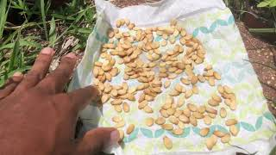
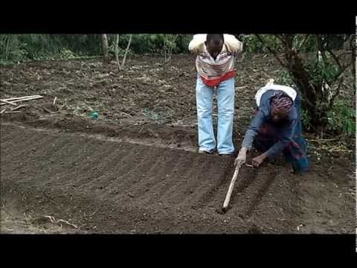
CONSERVING OUR ENVIRONMENT
1
Growing Climbing fruits
Developed by Charles Juma
Raising climbing fruit seedlings from seeds.
Extract seeds from a ripe fruit by cutting it into two.
Clean the seeds and dry them on direct sunlight.
Select good seeds and plant them in a prepared seedbed.
Take care of the seedbed by watering it regularly.
Transplant the seedlings once they are ready for transplanting.

Slide 17
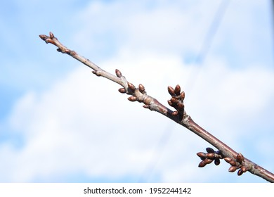
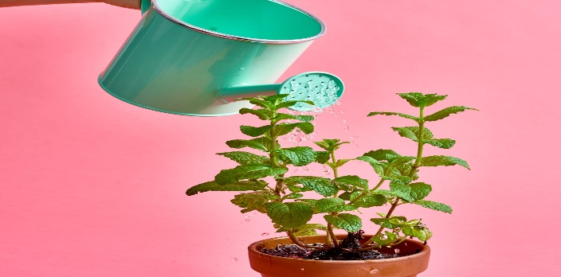
CONSERVING OUR ENVIRONMENT
1
Growing Climbing fruits
Developed by Charles Juma
Raising climbing fruit seedlings from cuttings.
Get a stem cutting.
Plant the stem cutting in sockets with its buds pointing up.
Water the planted stem every day.
Weeding should be done regularly by uprooting weeds.
Transplant the fruit to a different location when it starts producing roots and new leaves.

Slide 18
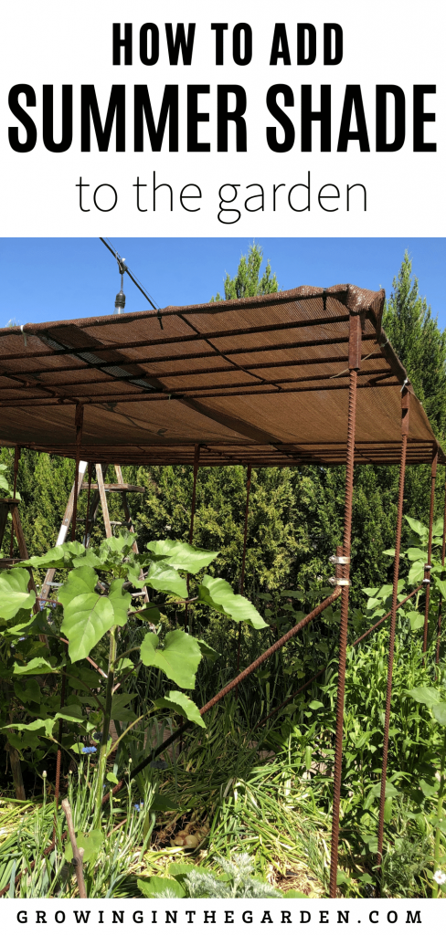
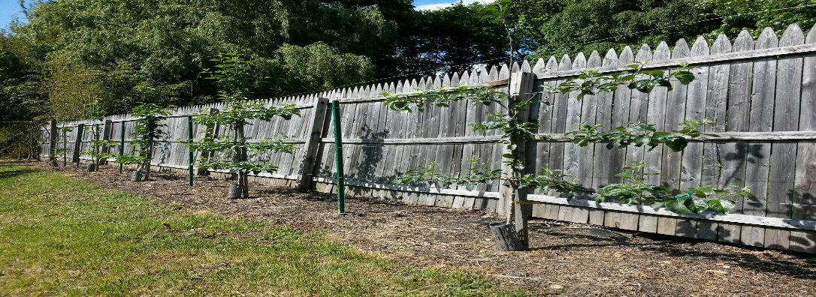
CONSERVING OUR ENVIRONMENT
1
Growing Climbing fruits
Developed by Charles Juma
Caring for young climbing fruit plants.
We should do the following to care for young climbing fruits.
Make a shade to protect them from heat and direct sunshine.
Construct a protective structure around them.
Construct a support structure using poles or wires to guide the plant. This is called training.
Water the fruit plant regularly at the root area.
Apply manure to the plant.
Protect the plant from any weeds by uprooting them.

Slide 19
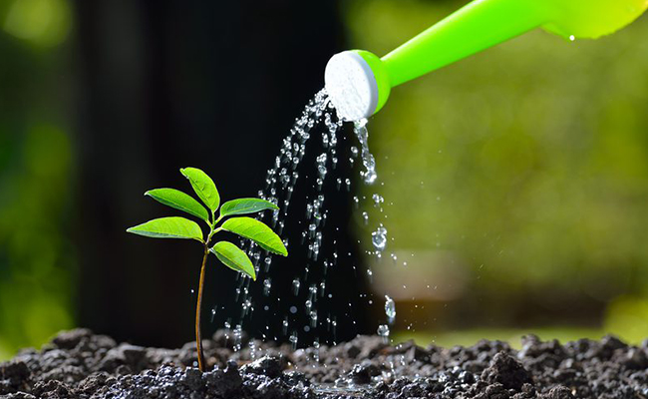
CONSERVING OUR ENVIRONMENT
1
Growing Climbing fruits
Developed by Charles Juma
Managing climbing fruit plants.
The planted climbing fruit plants should be managed through;
  Watering – should be done regularly to keep the soil moist.
  Manure application – is important to be done with an interval of about two months.
  Training the climbing plants – should be done about monthly to maintain them in order.

Slide 20
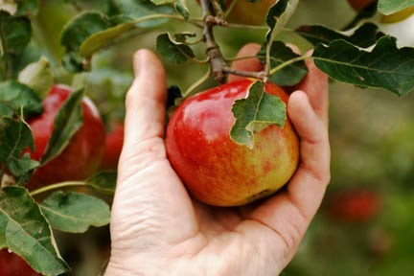
CONSERVING OUR ENVIRONMENT
1
Growing Climbing fruits
Developed by Charles Juma
Right stage for harvesting fruits.
We can know the right time to harvest fruits by;
Looking at their colour.
Checking their tenderness, soft fruits are ready to harvest.

Slide 21
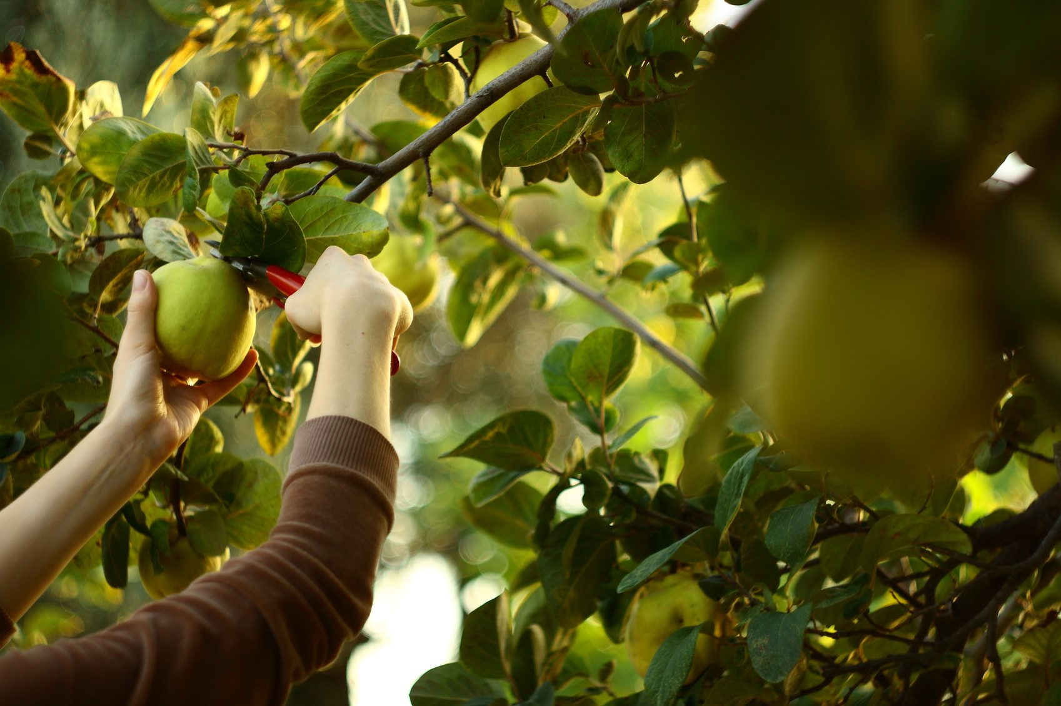
CONSERVING OUR ENVIRONMENT
1
Growing Climbing fruits
Developed by Charles Juma
Harvesting fruits
We should not pull fruits from climbing fruit plants. That can easily damage the fruits and the plant.
Tender fruits such as berries should be placed in small containers.
Fruits are important sources of food. We grow them to provide us with vitamins which protect our bodies from common diseases.
Fruit juice produces sugar that gives our body energy.

