Slide 1
d. Simple Distillation.
Distillation is the process of separation of mixtures where one substance evaporates and leaves the other in the container.
The substance that evaporates later condenses and is collected in another container.
Distillation method is used to separate solids that dissolves in liquids.
E.g Salt + water.

Slide 2
e.Sublimation
The change of state from solid to gaseous state is called Sublimation.
Sublimation method is used to separate solid – solid mixtures where one of the solid material in the mixture changes from solid to gas without passing through the liquid state.
Substances that undergo sublimation include:

Slide 3
Iodine
Ammonium Chloride
Aluminium Chloride
Iron (III) Chloride
Solid Carbon (iv) Oxide (Dry ice)
Draw diagram on page 64 fig 47.

Slide 4
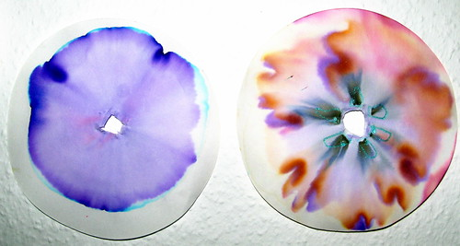
f. Paper Chromatography.
Is a process of separating different colour pigments from a mixture of colours.

Slide 5
The colour pigments spread outwards from the center forming cyclic rings of different colours.
A solvent like kerosene, ethanol or water is used to dissolve the colour pigments.
The colour pigments have different solubilities.
The pigment that is most soluble spreads the furthest.
The colour pigment with the least solubility spreads the least .

Slide 6
The two characteristics that make it possible to separate a mixture using paper chromatography are:
How easily a substance can dissolve in a solvent
How strongly a substance attaches its self on a filter paper.

Slide 7
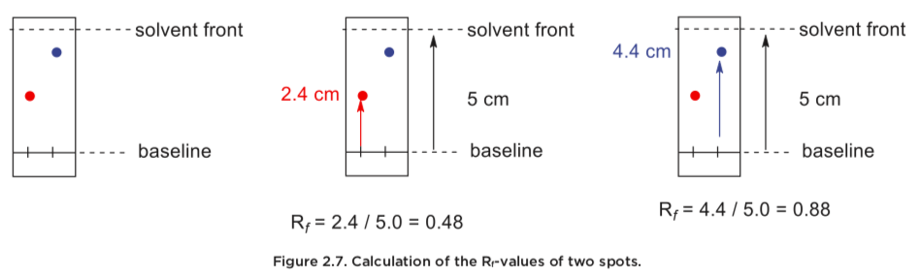
NB: The furthest point the solvent spreads is called solvent front.

Slide 8
Chromatography technique can be used in:
Sports to identify banned substances
Pharmaceuticals industry to test purity of drugs.
Food industry to determine contaminants in foods and drinks
Cosmetic industries to identify harmful substances.

